Slide 1
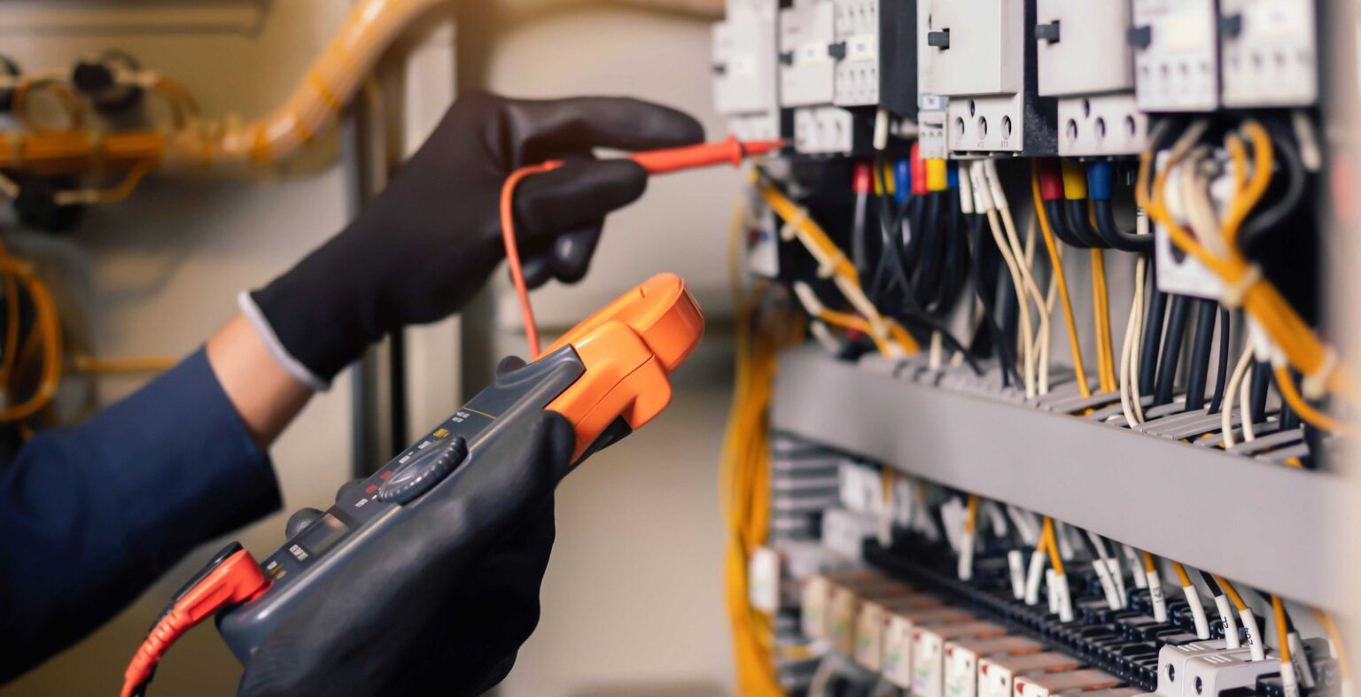
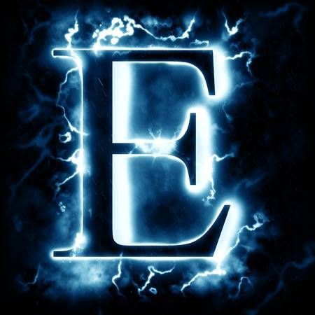
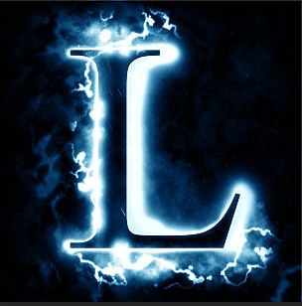
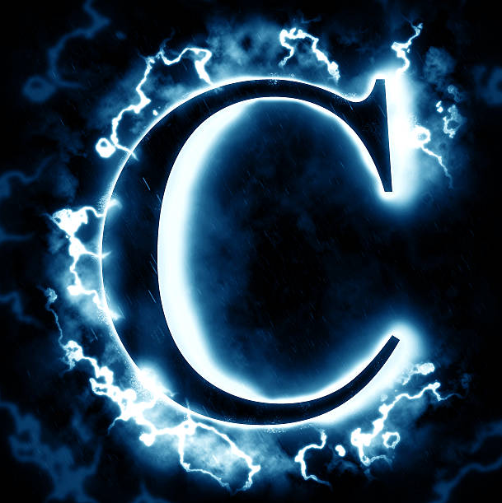
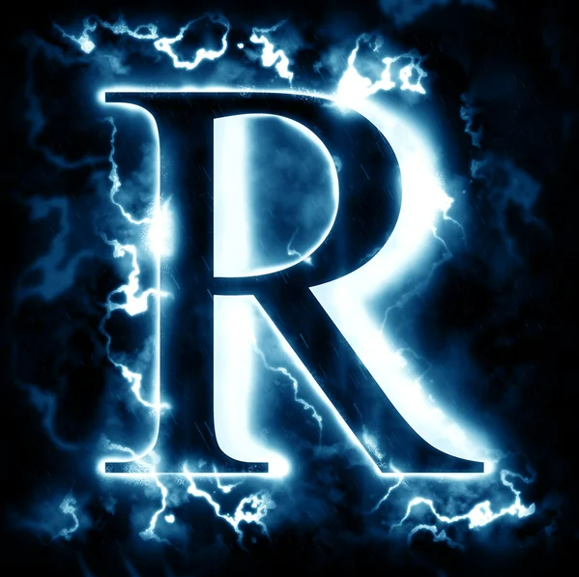
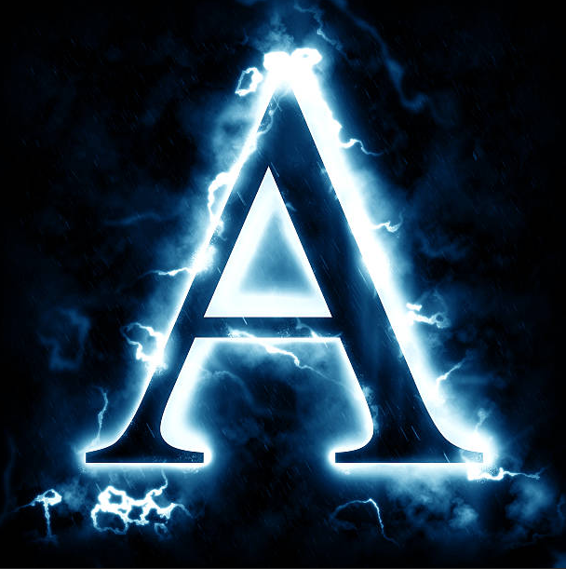
August Safety Meeting

Slide 2
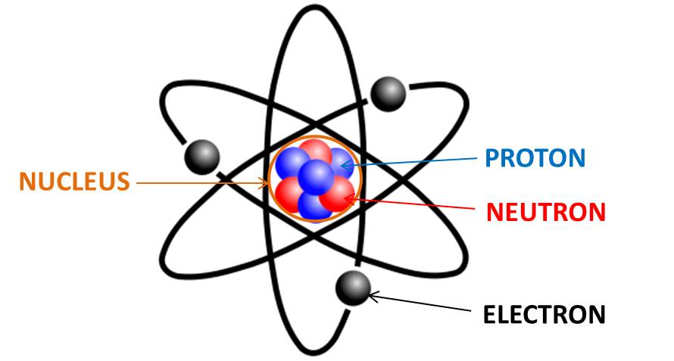
What IS Electricity?
Atoms:
Atoms are the building blocks of everything. Inside each atom are protons and neutrons, but it’s the electrons that orbit the atom (like the planets that orbit the sun) that matter for electricity.

Slide 3
What IS Electricity?
Flow of Electrons:
Electricity is the movement of electrons from one atom to the next in a path. This flow of electrons is called current and is measured using amps.

Slide 4
What IS Electricity?
Electricity in wires:
Electrical current moves through wires along a conductor – a material that allows electricity to flow easily. Around the wire is insulation which provides resistance – it keeps the electricity inside. Flow of electricity works like water in a pipe.

Slide 5
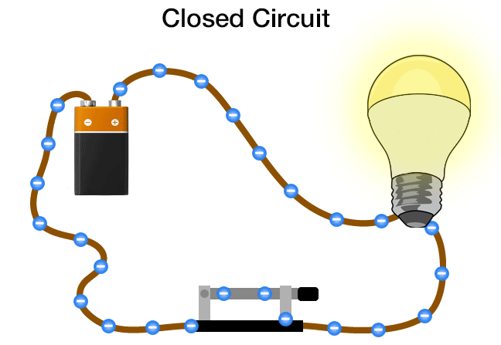
What IS Electricity?
Electrical Circuit:
Electrical current moves along a circuit – a path for electricity to flow from power source to the object being powered. Light switches, fuses, and relays can break the flow, like the water turned off in the pipe.

Slide 6
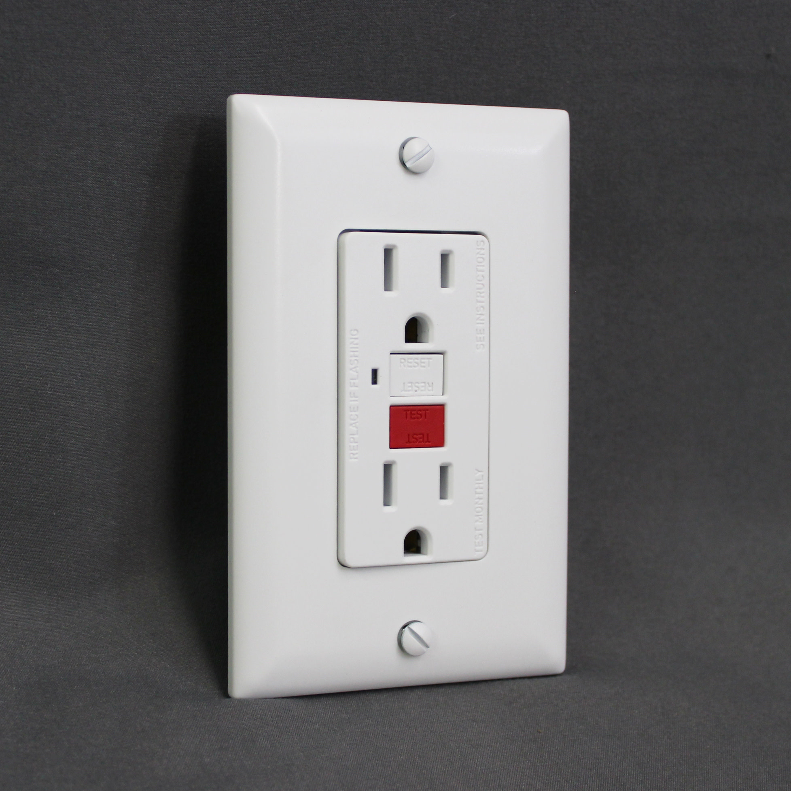
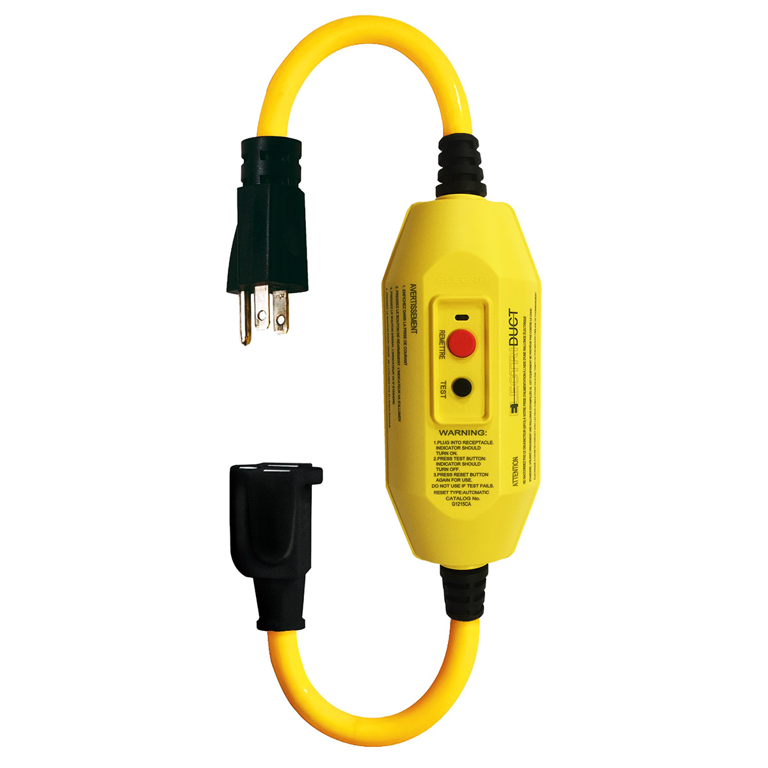
Takeaways:
Electrical Outlets:
GFCI (ground fault circuit interrupter) outlets should be installed (outlets with the test/reset buttons) – these protect you from electrical shock.
If the outlet is NOT a GFCI outlet, then you should use a GFCI adapter.

Slide 7
Takeaways:
Water and Electricity DO NOT MIX!:
NEVER use electrical equipment around water.

Slide 8
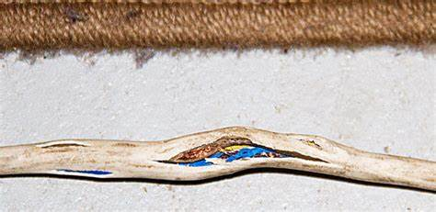
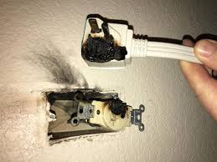
Takeaways:
Extension / Power Cords:
Frayed or exposed extension cords and power cords pose a SERIOUS shock/fire risk. These cords should be IMMEDIATELY removed from service.
Extension cords can NEVER be a permanent source of energy, only temporary.

Slide 9
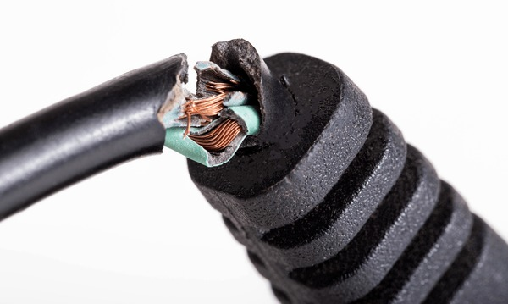
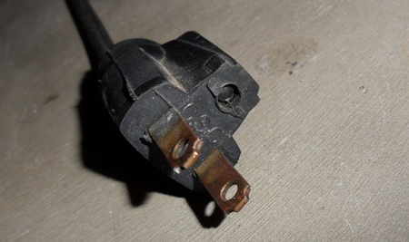
Takeaways:
Extension / Power Cords:
All pins should be present. NEVER use power / extension cord with a missing pin, including the ground pin.
ALWAYS inspect all cords, whether part of equipment or separate cord, for any damage to the cord or plug. Remove damaged cord from service.

Slide 10
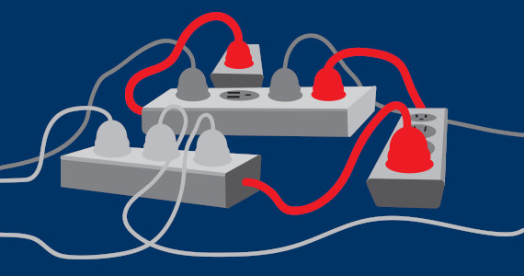
Takeaways:
Power Strips:
Power strips can be SERIOUS shock/fire hazards. NEVER plug equipment that uses a lot of electricity to power, such as personal heaters, into power strips. NEVER daisy chain power strips!

Slide 11
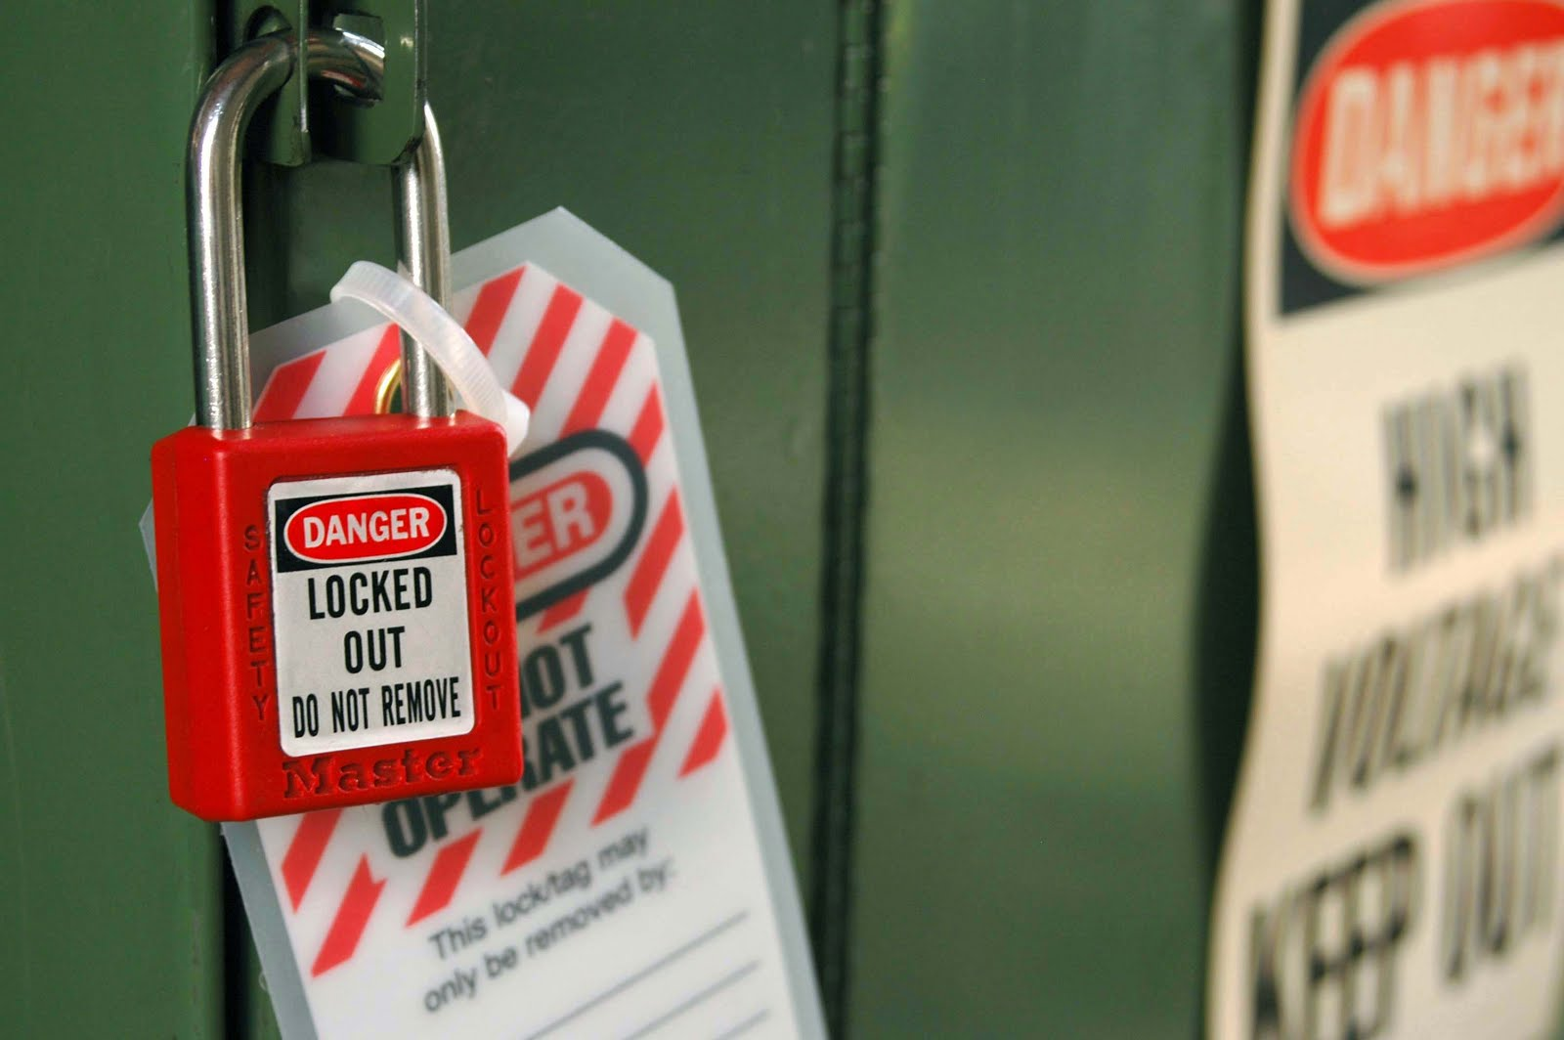
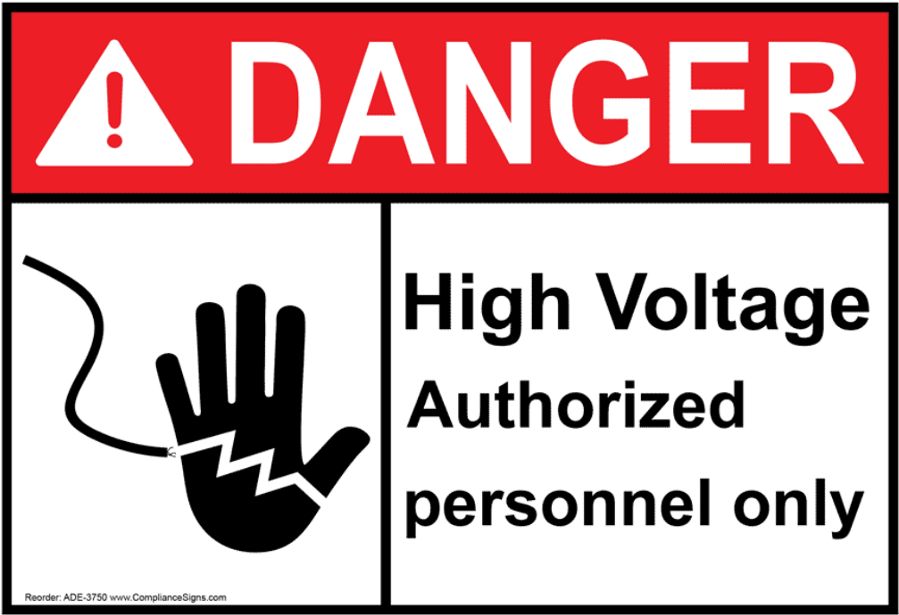
Takeaways:
Lockout / Tagout:
Lockout / Tagout is the primary way we can protect ourselves from electrical hazards. Never attempt to work on ANYTHING electrical unless you have been trained and authorized.
Only a few technicians are authorized for electrical work.

Slide 12
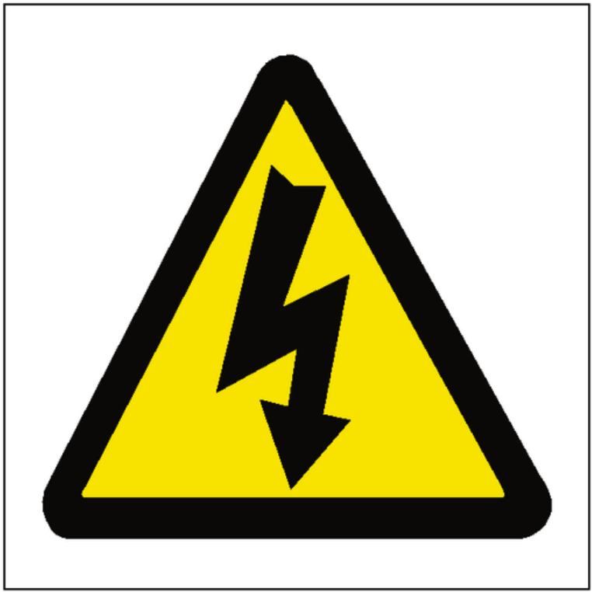
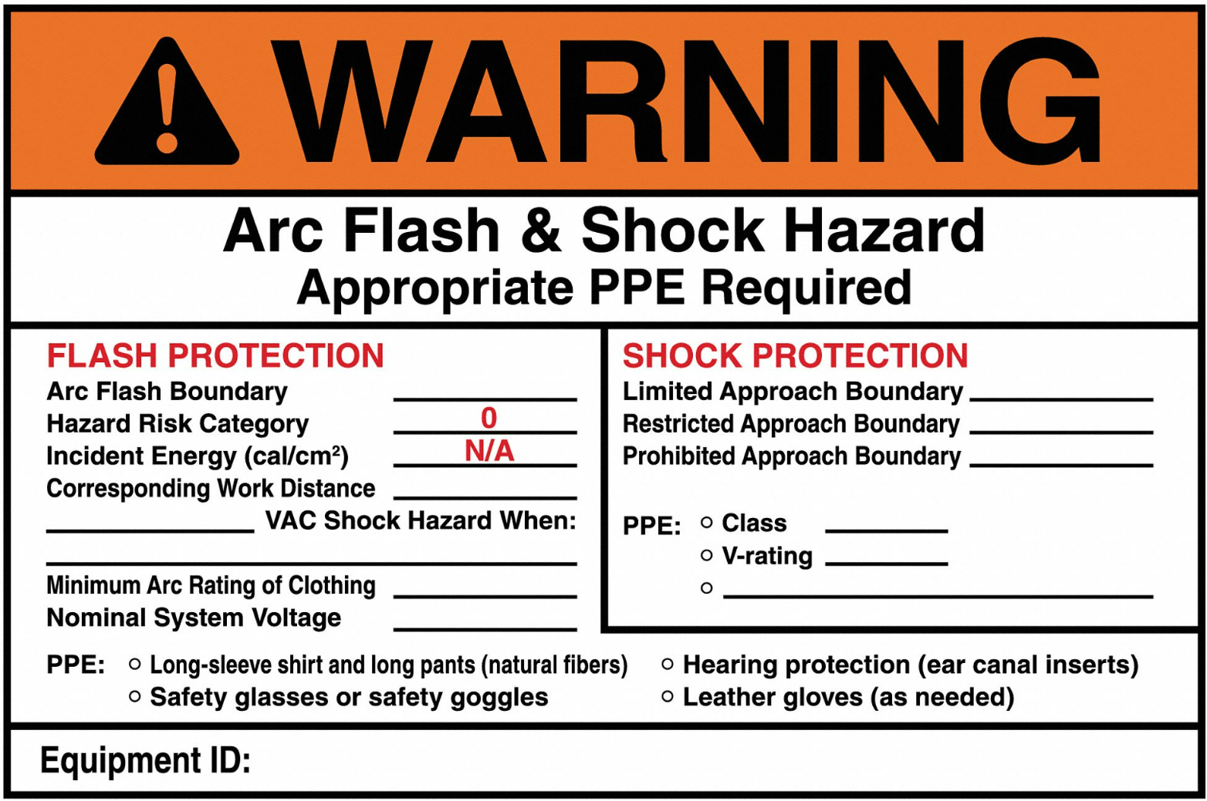
Takeaways:
Electrical Warning Labels:
The yellow triangle with the downward bolted arrow indicates high voltage – do NOT touch anything with this label.
Arc Flash labels indicate the equipment-specific hazard information.

Slide 13
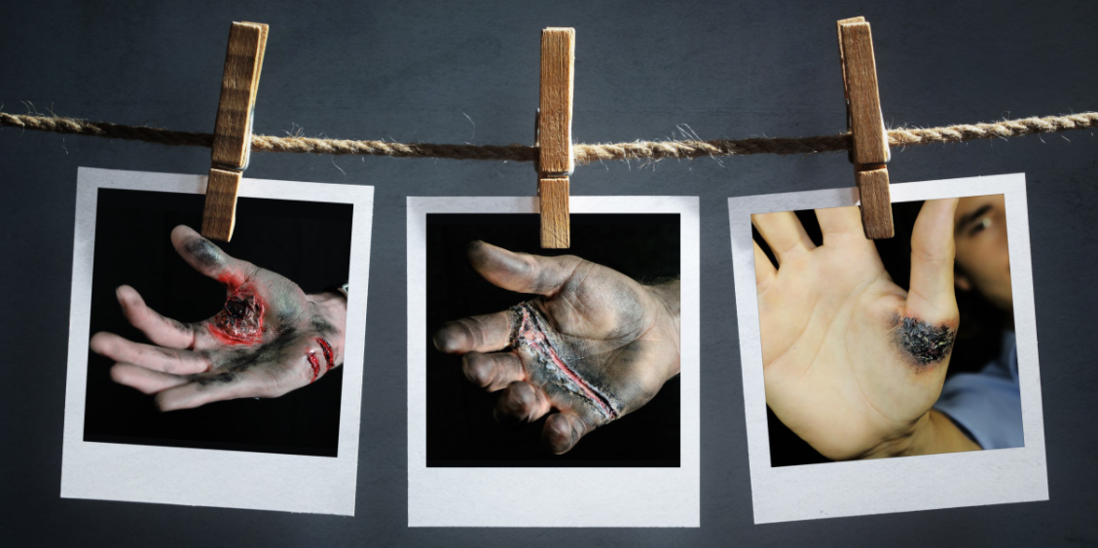
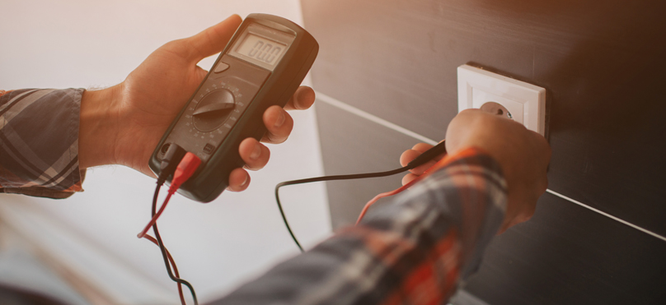
Takeaways:
Electricity CAN kill you!:
Electricity is a real and serious hazard. Do not underestimate it! Stay away from any source of electricity on which you have not been trained!
Be your brother’s and sister’s keepers. If you see something not right, say something!

Slide 14
QUESTIONS?

