Slide 1
Safety Performance – Safety Suggestions and Improvements
0WB leads the way with 9 safety suggestions for 2024.
A total of 67 proactive and other safety improvements have been made through August 2024.
A total of $9,580 has been spent on safety improvements YTD.
Continue to encourage all personnel in submitting safety suggestions.
Total Safety Suggestions - 2024
33

Slide 2
Safety Message – Most Common Workplace Injuries
Slips, trips and falls are the #1 cause for workplace accidents.
All drop cords should be eliminated or replaced with a permanent solution
All areas should be free of clutter and should be organized
The # 2 cause “Struck by Object or Equipment is much higher than the construction industry
# 3 “Overexertion lifting injuries” poses the next biggest risks in our facility
Train personnel to use proper lifting techniques
Implement an ergonomic stretching program

Slide 3
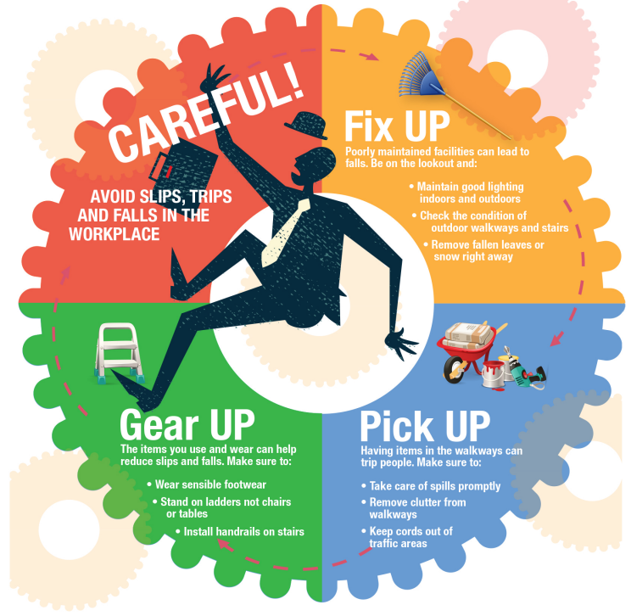
Safety Message – Slips, Trips and Falls
Keep all work areas clean!
Maintain good lighting.
Keep aisleways and walkways unobstructed and free of clutter.
No extension cords on the floor.
Wear shoes with good traction.
Clean up spills immediately!

Slide 4
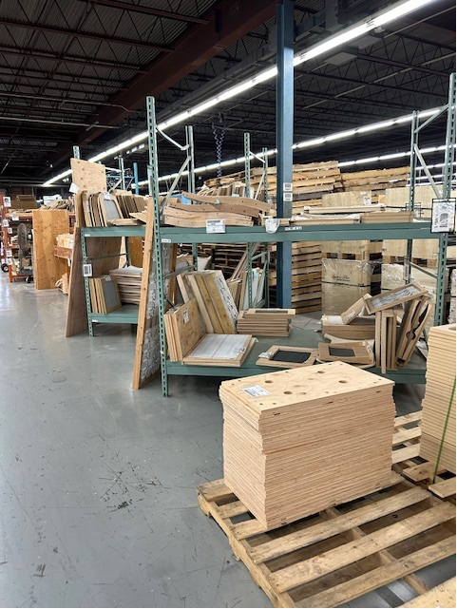
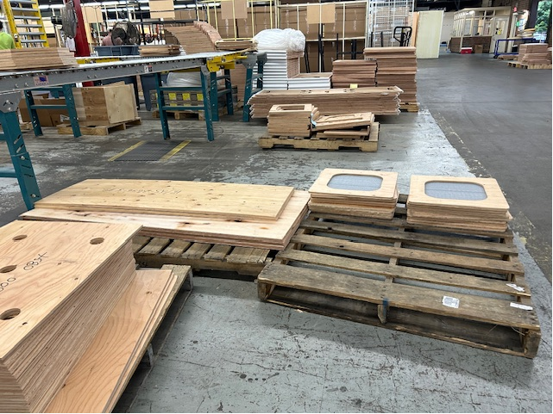
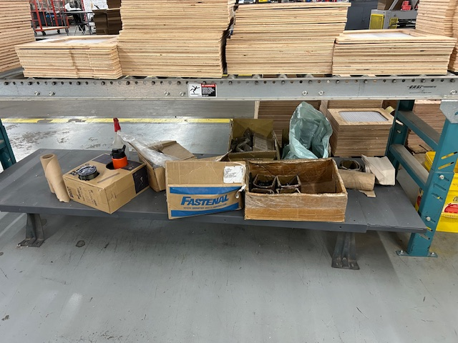
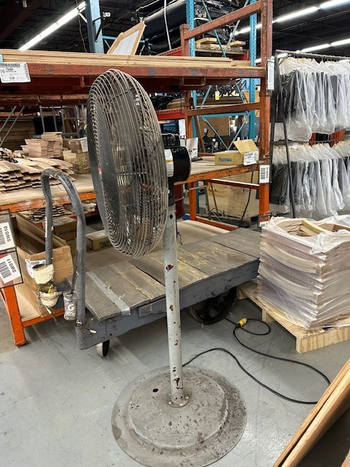
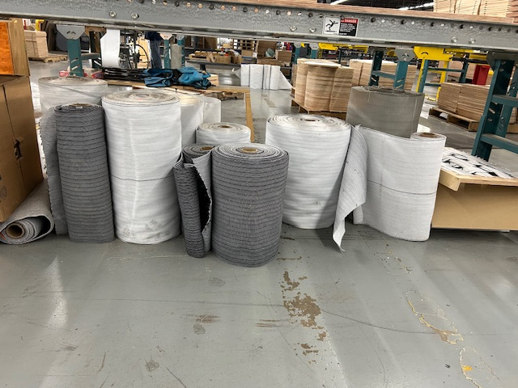
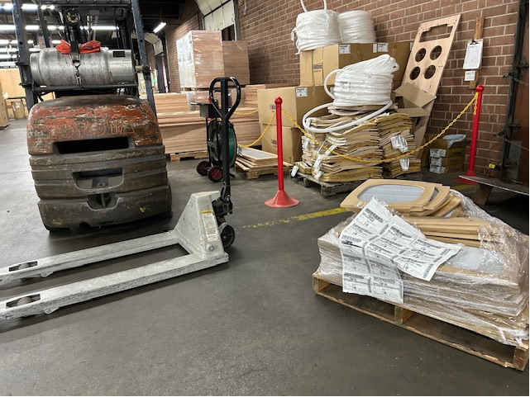
6S Project – 0WB (Before Pics) 7/29/24 – 8/02/24
Pallets stored everywhere, in the way of production, posed a safety risk, and made it difficult to count parts during inventory.
Rolls had not designated storage area and sat in the floor.
The dock wall was full of pallets that were finished goods, sitting next to the quarantine area and cluttered up the area.
Part boxes and other items were cluttered underneath tables and desks.

Slide 5
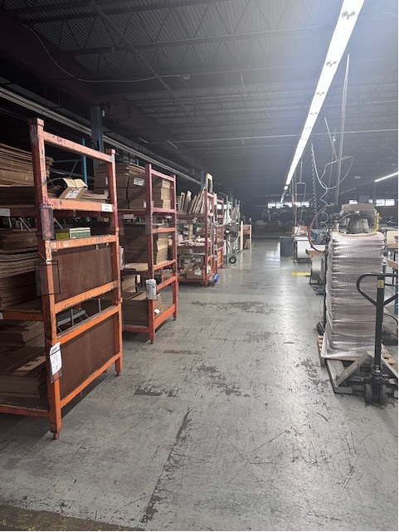
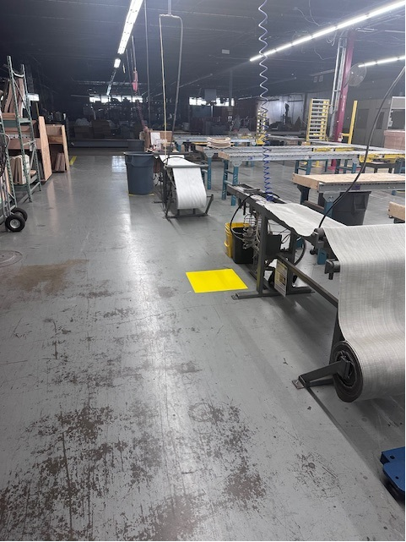
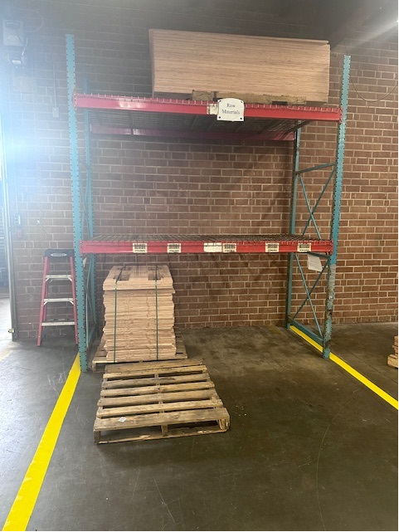
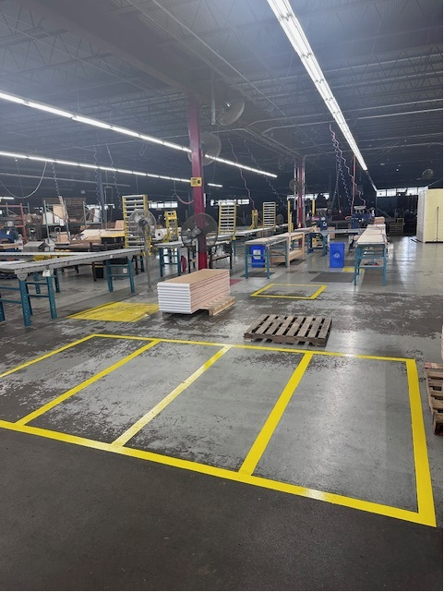
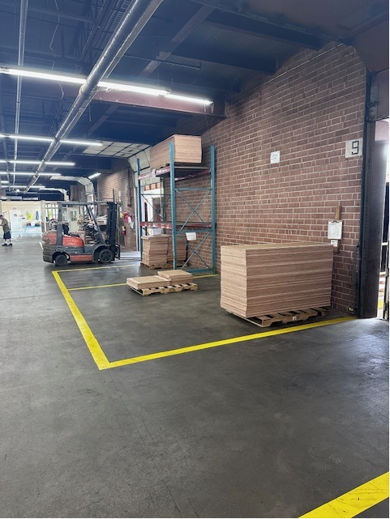
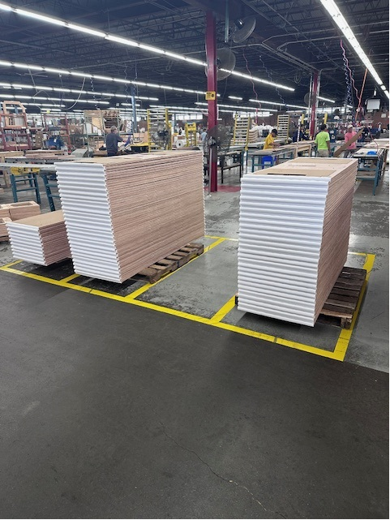
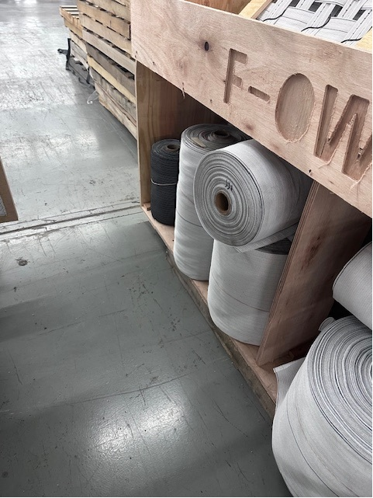
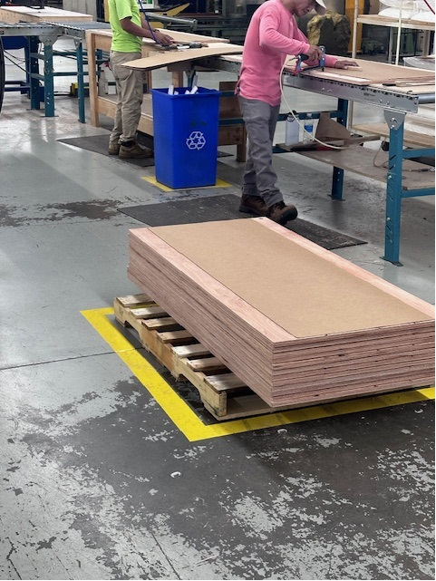
6S Project – 0WB (After Pics) 7/29/24 – 8/02/24
Adding storage shelves on the dock wall for finished goods and raw materials; all excess is now stored in the warehouse (areas are labeled and marked – nothing can go outside the yellow boxes.
Reorganized all WIP shelving.
Built a storage area for all fabric rolls.
Have designated boxes for WIP pallets.
Relocated the quarantine area to separated it from good material.
Added storage totes under the tables and desks for supplies.

